Slide 1
FPU issues & solution
Nov-17, 2021

Slide 2
Next steps
1. Algo Mul
2. Algo Div
3. Algo SQRT

Slide 3
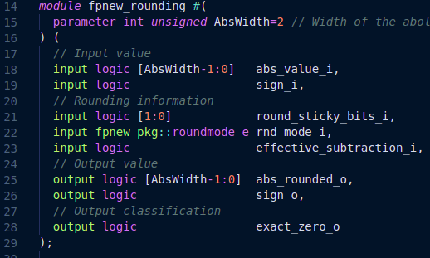
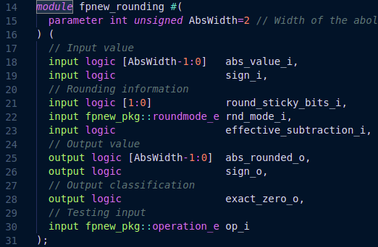


RDN error in multiplication
OLD RTL, version v0.0.0
NEW RTL, version v0.0.1

Slide 4
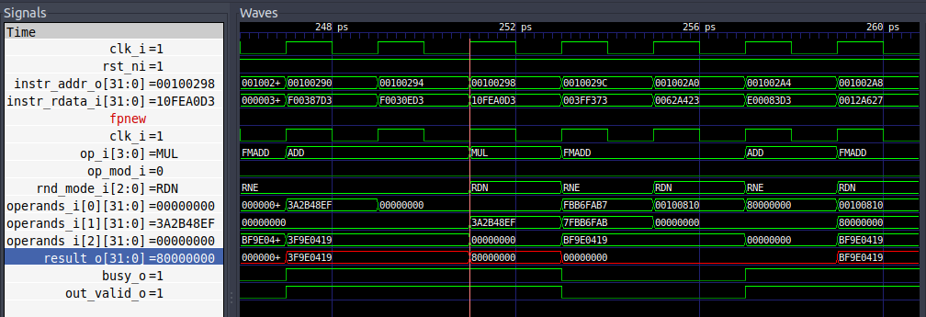
RDN error in multiplication
OLD Waveforms

Slide 5
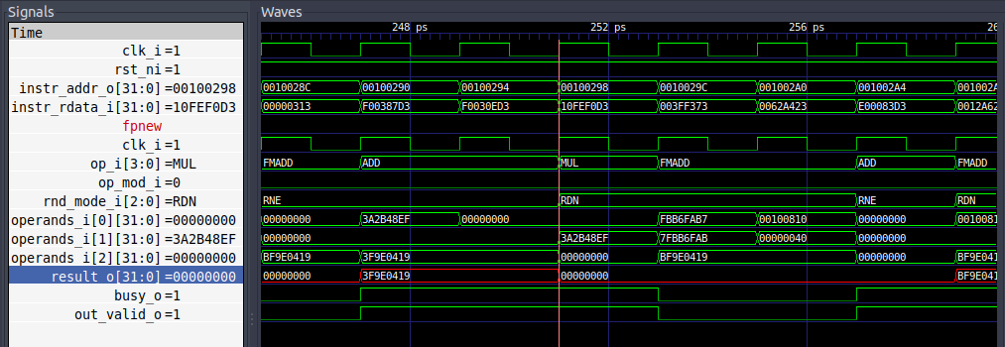
RDN error correction in multiplication
NEW Waveforms

Slide 6
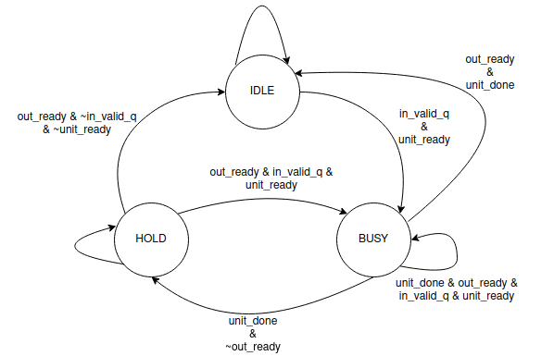
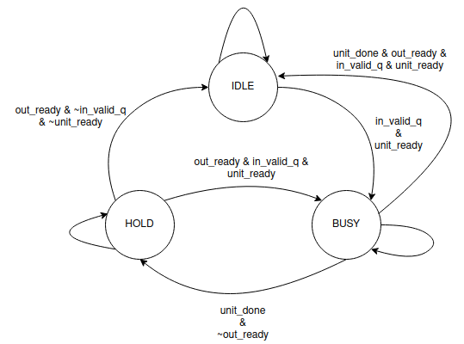
FDIV busy error
Old state diagram
New state diagram

Slide 7
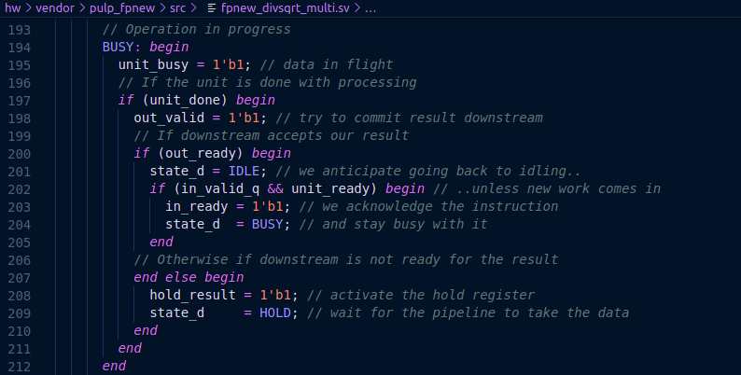
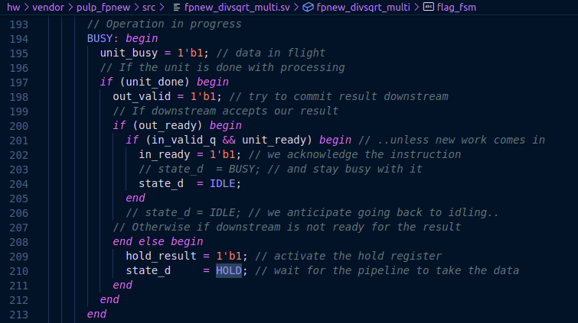
FDIV
OLD RTL, v0.0.0
New RTL, v0.0.1

Slide 8
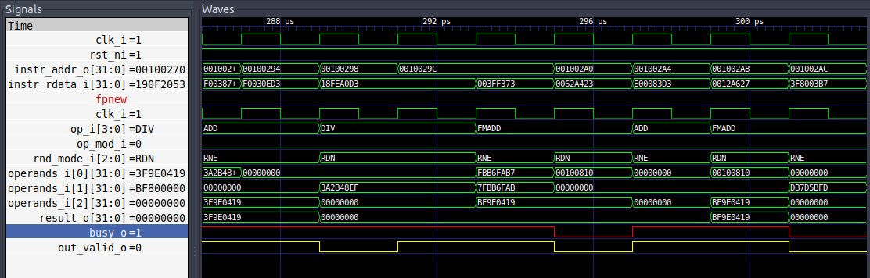
FDIV
OLD Waveforms

Slide 9
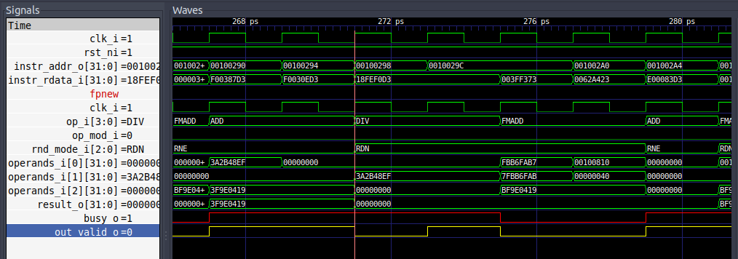
FDIV
NEW Waveforms

Slide 10
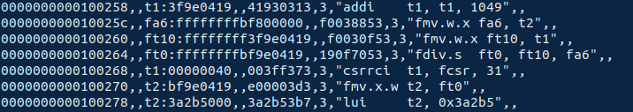
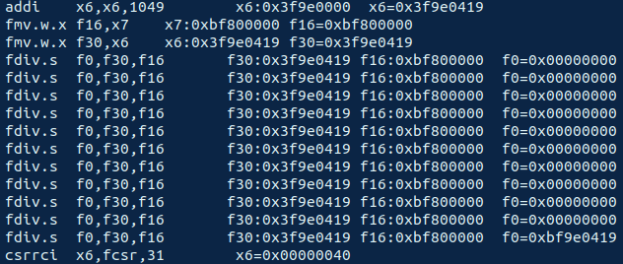
Log file correction
ISS log
RTL log

Slide 11
FDIV/FSQRT (RDN, RUP) error
Test | Instruction | RS1 | RS2 | RD (core) | RD (spike)
FDIV-S-DYN-RUP-01 | fdiv.s f3,f27,f13 | 0xc61a5229 | 0x4c50e7e7 | 0xb93d1c20 | 0xb93d1c1f
FDIV-S-DYN-RDN-01 | fdiv.s f3,f27,f13 | 0xc61a5229 | 0x4c50e7e7 | 0xb93d1c1f | 0xb93d1c20
FSQRT-S-DYN-RDN-01 | fsqrt.s f0,f30 | 0x3f9e0419 | - | 0x3f8e37e4 | 0x3f8e37e3
FSQRT-S-DYN-RUP-01 | fsqrt.s f0,f30 | 0x3f9e0419 | - | 0x3f8e37e3 | 0x3f8e37e3
Detailed sheet

Slide 12
FDIV/FSQRT (RDN, RUP) correction
For FDIV / FSQRT RUP: [C_RM_PLUSINF]
Mant_roundUp_S = Mant_rounded_S & ~Sign_in_DI; // Before
Mant_roundUp_S = Mant_rounded_S & Sign_in_DI; // After
For FDIV / FSQRT RUP: [C_RM_MINUSINF]
Mant_roundUp_S = Mant_rounded_S & Sign_in_DI; // Before
Mant_roundUp_S = Mant_rounded_S & ~Sign_in_DI; // After
For FDIV/FSQRT RMM added: [C_RM_NEAREST_RMM]
Mant_roundUp_S = 0; //Need to change this...
Detailed sheet

Slide 13
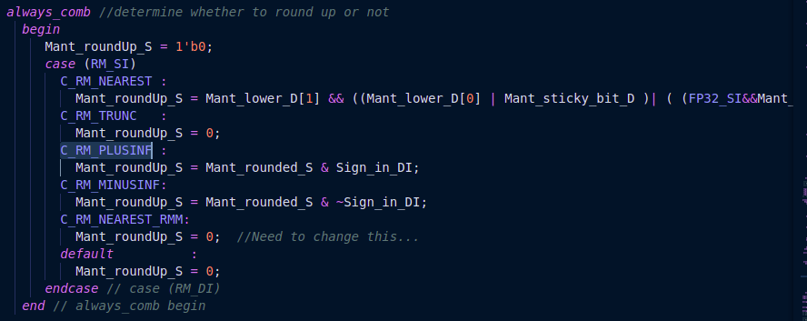
FDIV/FSQRT (RDN, RUP) correction
Detailed sheet

Slide 14
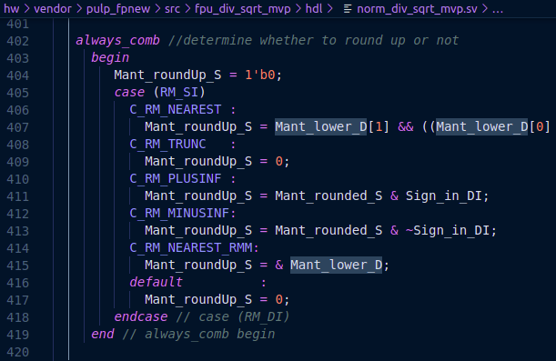
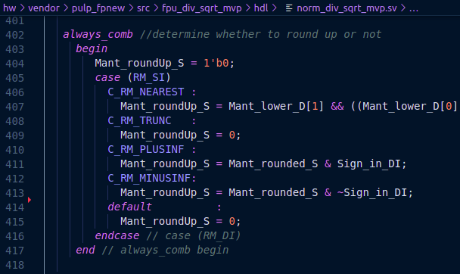
RMM Mode added
New RTL
Old RTL

